Slide 1


CSE 455 Software Testing
Lecture 12
This course is offered to the students of students of BS Software Engineering who are enrolled in 8th semester

Slide 2
Course instructor Yella mehroze
yellamehroze@cuilahore.edu.pk

Slide 3
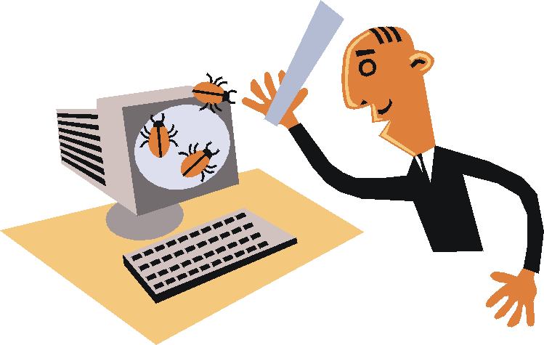
Bugs
Notes:
NOTE:
To change the image on this slide, select the picture and delete it. Then click the Pictures icon in the placeholder to insert your own image.

Slide 4
Outline
Characteristics of Good Test Cases
Fault, Error, Failure
Causes of Defect and Failure
Bug’s Lifecycle
Complicate Bug’s Life Cycle
Generic Bug’s Life Cycle
Consequences of Bugs
The Importance of Bugs
How Bugs Affect Us- Consequences
Flexible Severity Rather Than Absolutes
The Nightmare List and When to Stop Testing

Slide 5
Characteristics of Good Tests
Power
When a problem exists, the test will find it
Validity
Problems found are genuine problems
Value
Test reveals things clients want to know
Credibility
Test is a likely operational scenario

Slide 6
Characteristics of Good Tests
Non-redundancy
Provides new information
Repeatability
Easy and inexpensive to re-run
Maintainability
Test can be revised as the product is revised
Coverage
Exercises the product in a way not already tested for

Slide 7
Characteristics of Good Tests
Ease of evaluation
Results are easy to interpret
Diagnostic power
Helps pinpoint the cause of problems
Accountability
You can explain, justify and prove you ran it
Low cost
Time and effort to develop + time to execute
Low opportunity cost
Is a better use of your time than other things you could be doing…

Slide 8
Fault, Error, Failure
Fault (): A fault is the adjudged cause of an error. It is a condition that causes the software to fail to perform its required function.
Error: An error is a state of the system which refers to the difference between Actual Output and Expected output.In the absence of any corrective action by the system, an error state could lead to a failure
Defect: An error found by tester is called defect.
Bug: Defect accepted by development team then it is called Bug.
Failure: A failure is said to occur whenever the external behavior of a system does not conform to that prescribed in the system specification.
fault→error→failure.

Slide 9
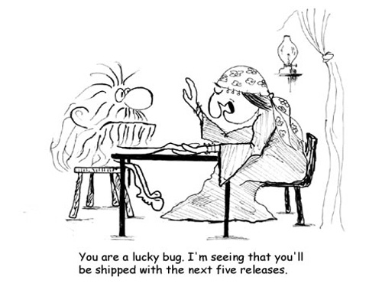
Causes of Defects and Failure
Causes of defects in software
Missing requirements
Wrong specification
Requirement that was infeasible
Faulty system design
Wrong algorithms
Faulty implementation
Defects may lead to failures
But the failure may show up somewhere else
Tracking the failure back to a defect can be hard

Slide 10
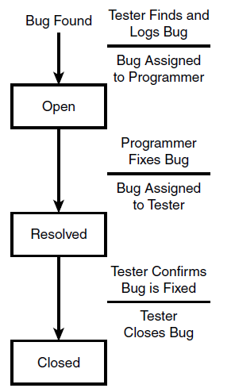
Bug’s Life Cycle
Life Cycle- refers to the various stages that a bug undergoes over its life
Bug’s State Diagram

Slide 11
Bug’s Life Cycle
Open State- in this state a bug is found by a software tester, a report is logged and assigned to a programmer to be fixed
Resolved State- Once the programmer fixes the code, he assigns the report back to the tester and the bug enters the resolved state
Closed State- The tester then performs a verification test to confirm that the bug is indeed fixed and, if it is, close the report. The bug then enters its final state, the closed state.

Slide 12
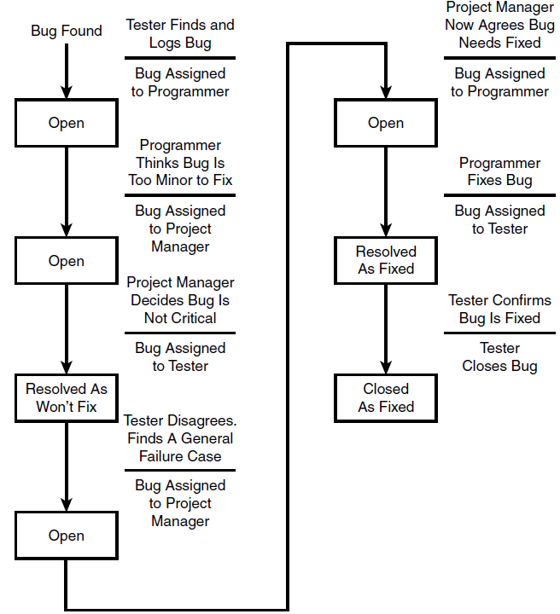
Complicated Bug’s Life Cycle

Slide 13
Complicated Bug’s Life Cycle
Complicated bug might undergo numerous changes and iterations over its life
Sometimes looping back
Starting the life cycle all over again
Possible decisions, approvals, and looping that can occur in most projects can be shown in generic state diagram

Slide 14
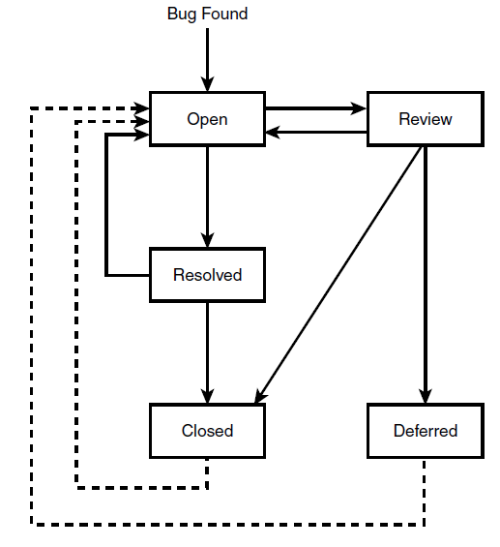
Generic Bug’s Life Cycle

Slide 15
Generic Bug’s Life Cycle
Generic life cycle has two additional states and extra connecting lines.
Review State:
The review state is for decision whether bug should be fixed
Project manager
Change Control Board
In some projects all bugs go through the review state
In other projects, this may not occur until near the end of the project, or not at all.
The review state can also go directly to the closed state
Deferred:
In deferred state the review may determine that the bug should be considered for fixing in future but not for this release of the software

Slide 16
Generic Bug’s Life Cycle
A deferred bug could later be proven serious enough to fix immediately.
A bug that was thought to be fixed, tested, and closed could reappear. Such bugs are often called regressions
In above both this cases, the bug is reopened and started through the process again

Slide 17
Consequences of Bug
The Importance of Bugs
How Bugs Affect Us- Consequences
Flexible Severity Rather Than Absolutes
The Nightmare List and When to Stop Testing

Slide 18
1. Importance of Bugs
Frequency- How often does a kind of bug occur? You should pay more attention to the more frequent bug types.
Correction Cost- What does it cost to correct the bug after it has been found? The cost is sum of two factors
The cost of discovery
The cost of correction (depends on system size)

Slide 19
1. Importance of Bugs
Installation Cost- Depends on the number of installations
Small for a single user program
Installation can dominate all other costs- fixing one simple bug and distributing the fix could exceed the entire system’s development cost.
Consequences- What are the consequences of the bug?
Bug importance can be computed by
Importance ($)=frequency * (correction_cost + installation_cost + consequential cost)

Slide 20
2. How Bugs Affect Us
Mild- The symptoms of the bug offend us aesthetically. E.g. a misspelled output or a misaligned printout.
Moderate- Outputs are misleading or redundant. The bug impacts system’s performance
Annoying- The system’s behavior, because of bug is de-humanizing. E.g. names are truncated or arbitrarily modified. Bill for $0.0 are sent.
Disturbing- It refuses to handle legitimate transactions. E.g ATM won’t give you money. Your credit card is declared invalid.
Serious- It loses track of transactions: not just the transaction itself (your paycheck), but the fact that the transaction occurred. Accountability is lost.
Notes:
The on/off button that swiches state, so when the system is off it is green to indicate that you can turn it on and when it is on the button is red to indicate that you can turn it off. To me, this is counterintuitive.

Slide 21
2. How Bugs Affect Us
Very Serious- The bug causes the system to do wrong calculations, transactions etc. Instead of losing your paycheck, the system credits it to another account.
Extreme- The problems are not limited to few users or to a few transaction types.
Intolerable- Long-term, unrecoverable corruption of the database occurs and the corruption is not easily discovered. Serious consideration is given to shutting the system down
Catastrophic- The decision to shut down is taken out of our hands because the system fails.
Infectious- A system that corrupts other systems even though it does not fail in itself that erodes the social or physical environment.

Slide 22
3. Flexible Severity Rather than Absolute
We cannot say that software has 0 or 100 % quality
Quality can be measured on some scale, say from 0 to 10
Quality can be measured as a combination of factors, of which the number of bugs and their severity is only one component
Some of the factors on which quality depends may include environment, application, culture etc

Slide 23
3. Flexible Severity Rather than Absolute
Correction Cost- The cost of correcting a bug has almost nothing to do with symptom severity.
Catastrophic, life threatening bugs could be trivial to fix
Minor annoyances could require major rewrites to correct
Context and Application Dependency- The severity of a bug, for the same bug or same symptoms, depends on context.
E.g. a round off error in an orbit calculation doesn't mean much in a spaceship video game but it meters to real astronauts.

Slide 24
3. Flexible Severity Rather than Absolute
Creating Culture Dependency- What’s important depends on the creators of the software and their cultural aspirations.
User Culture Dependency- What’s important depends on the user culture.
An R & D shop might accept a bug for which there is a workaround. A banker would go to jail for that same bug.
The Software Development Phases- Severity depends on development phase. A bug gets more severe and correction cost dramatically rises
As it gets closure to field use
The longer it has been around

Slide 25
4. The Nightmare List and When to Stop Testing
You and your organization must define their own nightmares
Here is a workable procedure to quantify your nightmares
List your worst nightmares. State them in terms of symptoms they produce and how your users will react to those symptoms
Convert consequences of each nightmare into cost
Order list from costliest to cheapest and then discard the low-concern nightmares
Based on your experience, measured data, intuition and published statistics populate the kinds of bugs that are likely to create symptoms expressed by each nightmare

Slide 26
The Nightmare List and When to Stop Testing
After developing a list of bugs for each nightmare, order that list by decreasing probability. Calculate the importance of bugs
Rank the bug types in order of decreasing order of importance to you.
Design tests and design your quality assurance inspection process by using effective methods
If a test is passed, then some nightmares or parts of them go away otherwise nightmare is possible. You have to revise your subsequent test strategy
Stop testing when probability of all nightmares reduces to satisfaction level

